Slide 1
Neural Networks
T.Heba Mohammed

Slide 2
Learning in Neural Networks
Neurons and the Brain
Neural Networks
Perceptrons
Multi-layer Networks

Slide 3
Introduction, or how the brain works
Machine learning involves adaptive mechanisms that enable computers to learn from experience
  learning by example.
Learning capabilities can improve the performance of an intelligent system over time.
The most popular approach to machine learning is artificial neural networks.

Slide 4
Neural Networks
A model of reasoning based on the human brain
complex networks of simple computing elements
capable of learning from examples
  with appropriate learning methods
collection of simple elements performs high-level operations

Slide 5
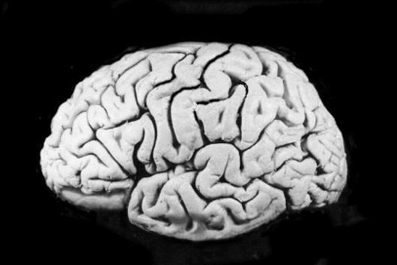
Neural Networks and the Brain
brain
  set of interconnected modules
  performs information processing operations
    sensory input analysis
    memory storage and retrieval
    reasoning
    feelings
    Consciousness
neurons
  basic computational elements
  heavily interconnected with other neurons
[Russell & Norvig, 1995]

Slide 6
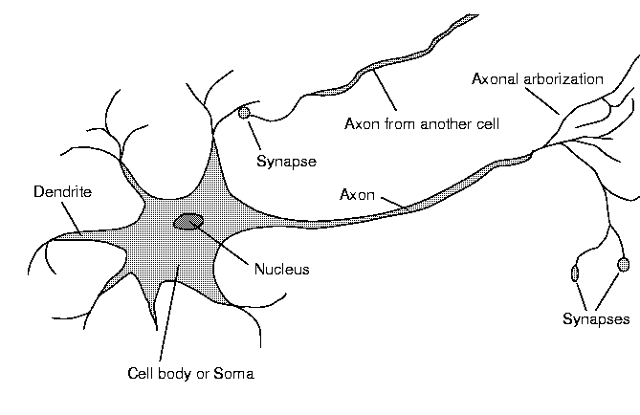
Neuron Diagram
soma
  cell body
dendrites
  incoming branches
axon
  outgoing branch
synapse
  junction between a dendrite and an axon from another neuron
[Russell & Norvig, 1995]

Slide 7
Neural Networks and the Brain (Cont.)
The human brain incorporates nearly 10 billion neurons and 60 trillion connections between them.
Our brain can be considered as a highly complex, non-linear and parallel information-processing system.
Learning is a fundamental and essential characteristic of biological neural networks.

Slide 8
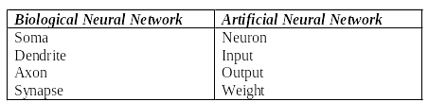
Analogy between biological and artificial neural networks

Slide 9
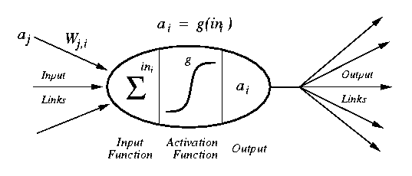
Artificial Neuron (Perceptron) Diagram
[Russell & Norvig, 1995]
weighted inputs are summed up by the input function
the (nonlinear) activation function calculates the activation value, which determines the output

Slide 10
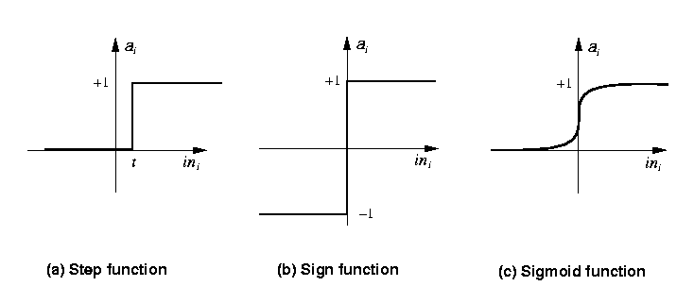
Common Activation Functions
[Russell & Norvig, 1995]
Stept(x) = 1 if x >= t, else 0
Sign(x) = +1 if x >= 0, else –1
Sigmoid(x) = 1/(1+e^{-x})

Slide 11
Network Structures
layered structures
  networks are arranged into layers
  interconnections mostly between two layers
  some networks may have feedback connections

Slide 12


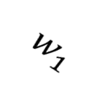
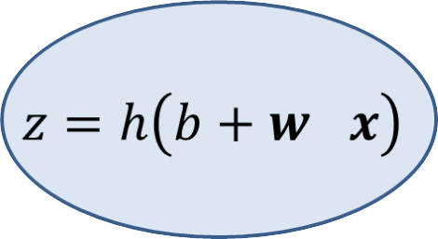


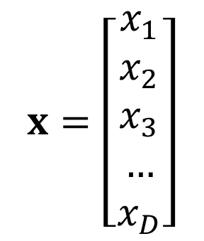
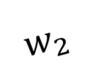




Perceptrons

Slide 13


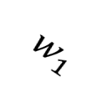
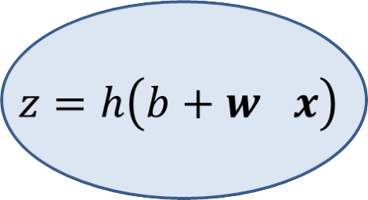

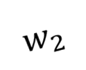



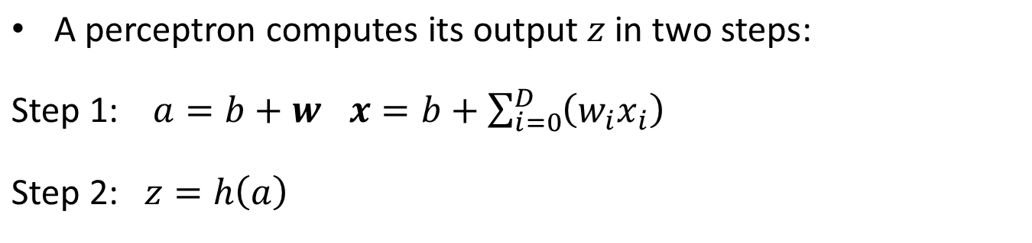
Perceptrons

Slide 14
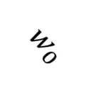
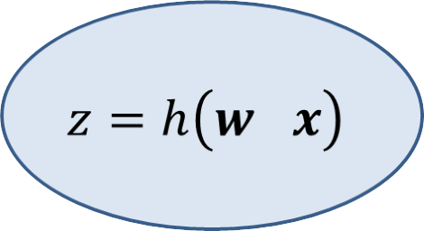
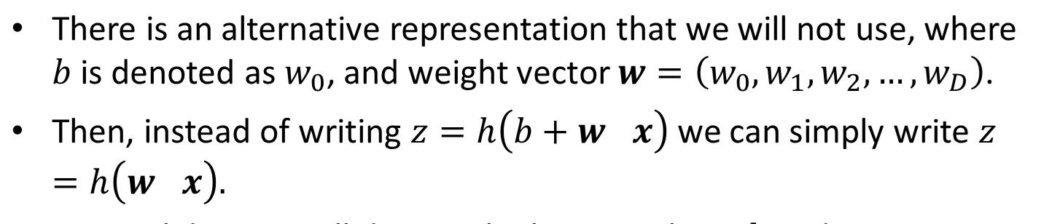
Notation for Bias Weight

Slide 15
Perceptrons and Neurons
Perceptrons are inspired by neurons.
  Neurons are the cells forming the nervous system, and the brain.
  Neurons somehow sum up their inputs, and if the sum exceeds a threshold, they "fire".
Since brains are "intelligent", computer scientists have been hoping that perceptron-based systems can be used to model intelligence.

Slide 16
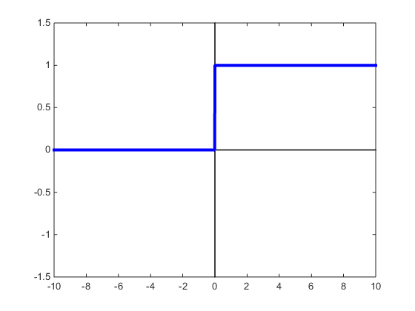
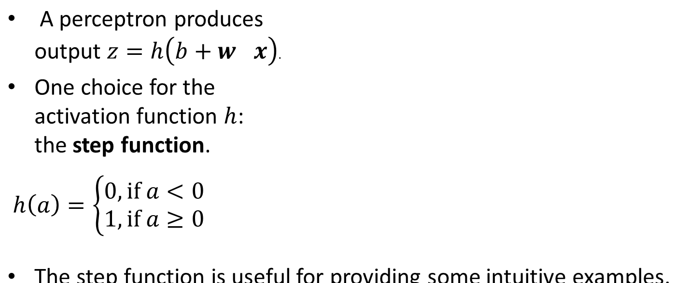
Activation Functions

Slide 17
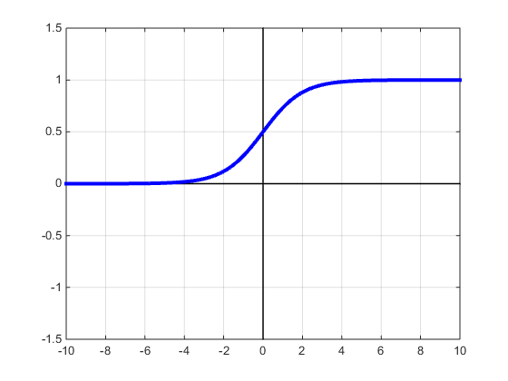
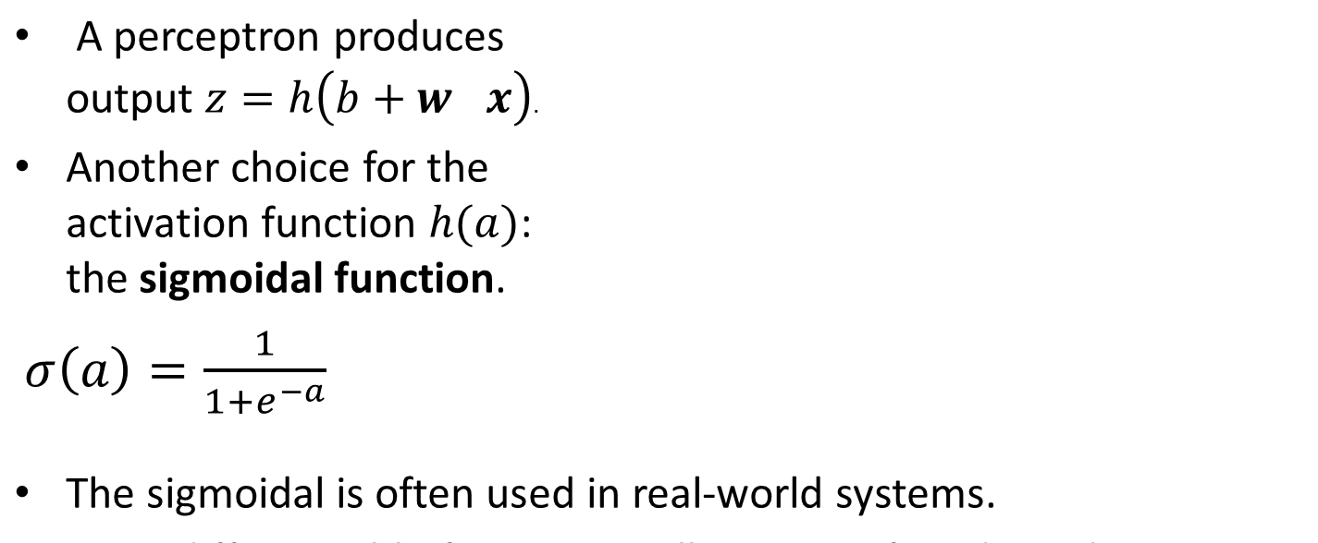
Activation Functions

Slide 18

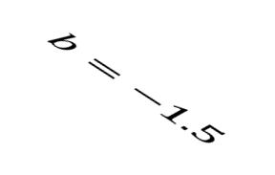
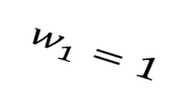



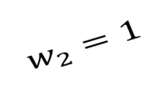

Example: The AND Perceptron
Suppose we use the step function for activation.
Suppose boolean value false is represented as number 0.
Suppose boolean value true is represented as number 1.
Then, the perceptron below computes the boolean AND function:
false AND false = false
false AND true = false
true AND false = false
true AND true = true

Slide 19
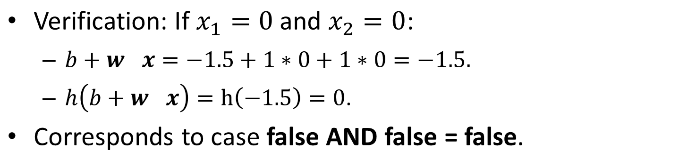
Example: The AND Perceptron
false AND false = false
false AND true = false
true AND false = false
true AND true = true

Slide 20
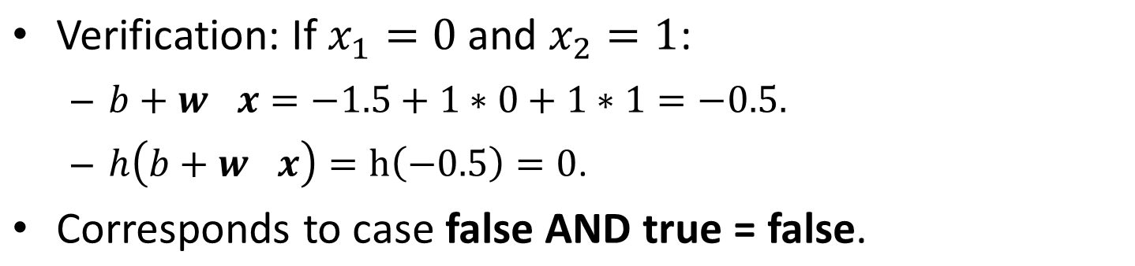
Example: The AND Perceptron
false AND false = false
false AND true = false
true AND false = false
true AND true = true

Slide 21
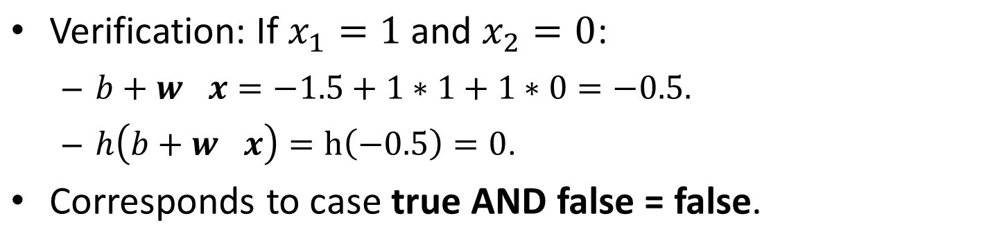
Example: The AND Perceptron
false AND false = false
false AND true = false
true AND false = false
true AND true = true

Slide 22
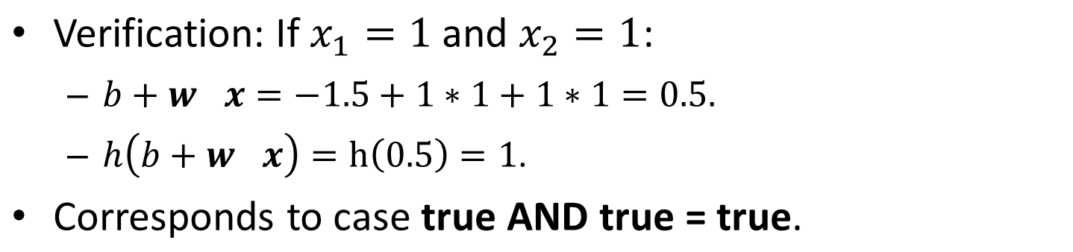
Example: The AND Perceptron
false AND false = false
false AND true = false
true AND false = false
true AND true = true

Slide 23
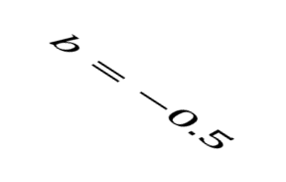
Example: The OR Perceptron
Suppose we use the step function for activation.
Suppose boolean value false is represented as number 0.
Suppose boolean value true is represented as number 1.
Then, the perceptron below computes the boolean OR function:
false OR false = false
false OR true = true
true OR false = true
true OR true = true

Slide 24
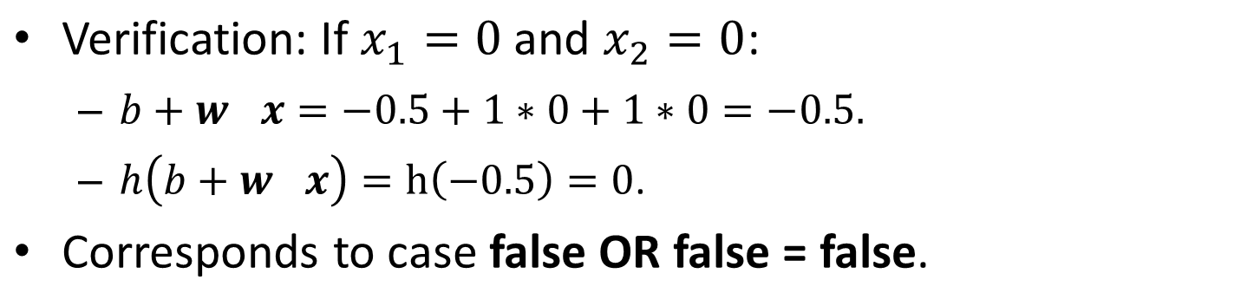
Example: The OR Perceptron
false OR false = false
false OR true = true
true OR false = true
true OR true = true

Slide 25
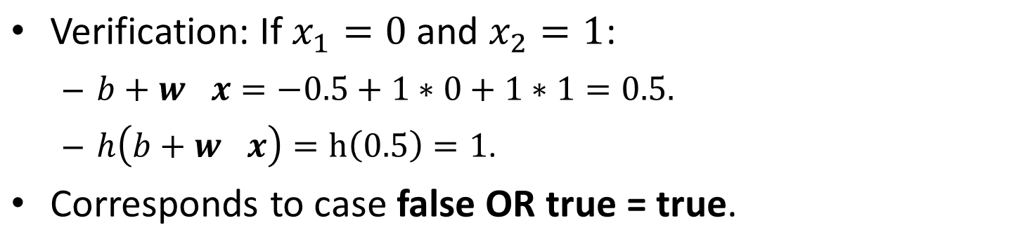
Example: The OR Perceptron
false OR false = false
false OR true = true
true OR false = true
true OR true = true

Slide 26
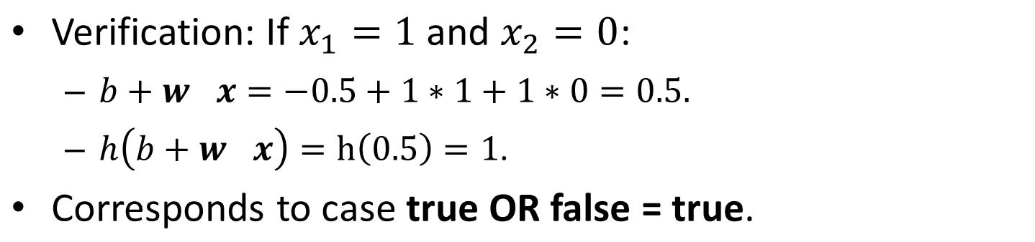
Example: The OR Perceptron
false OR false = false
false OR true = true
true OR false = true
true OR true = true

Slide 27
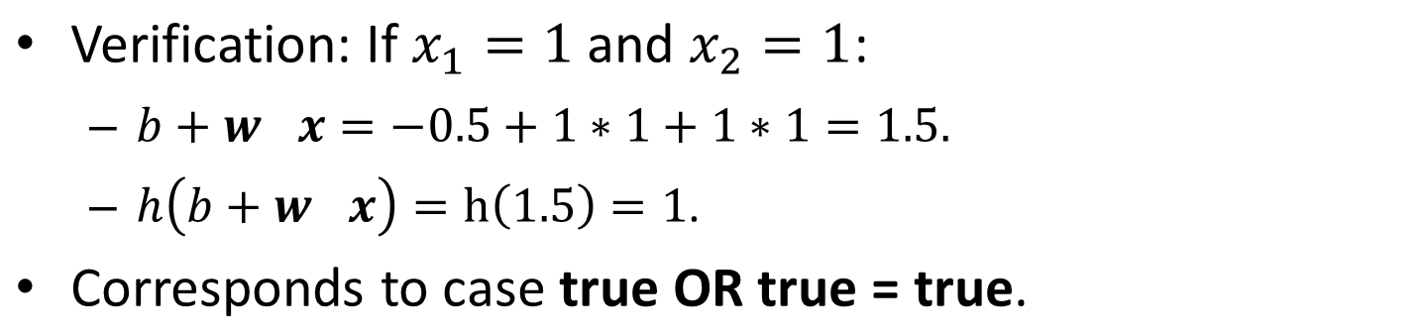
Example: The OR Perceptron
false OR false = false
false OR true = true
true OR false = true
true OR true = true

Slide 28
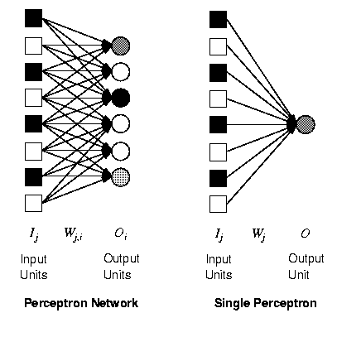
Perceptrons
single layer, feed-forward network
historically one of the first types of neural networks
  late 1950s
the output is calculated as a step function applied to the weighted sum of inputs
capable of learning simple functions
  linearly separable
[Russell & Norvig, 1995]

Slide 29
Perceptron
In 1958, Frank Rosenblatt introduced a training algorithm that provided the first procedure for training a simple ANN: a perceptron.
The aim of the perceptron is to classify inputs (x1, x2, . . ., xn) into one of two classes, say A1 and A2.

Slide 30
Perceptrons and Linear Separability
0,1
1,1
0,1
1,1
0,0
1,0
0,0
1,0
AND
XOR
[Russell & Norvig, 1995]
perceptrons can deal with linearly separable functions
some simple functions are not linearly separable
  XOR function

Slide 31
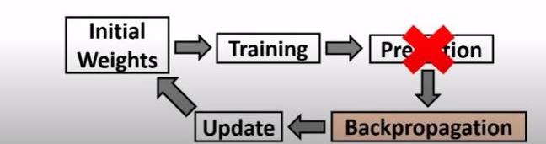
How does the perceptron learn its classification tasks?

Slide 32

How does the perceptron learn its classification tasks?
The initial weights are randomly assigned
  usually in the range [−0.5, 0.5], or [0, 1]
  Find sum of product s=x1*w1+x2*w2+b
Apply activation function
perceptrons can learn from examples through a simple learning rule. For each example row (iteration), do the following:
  calculate the error of a unit Err_{i} as the difference between the correct output T_{i} and the calculated output O_{i}
  Err_{i} = T_{i} - O_{i}
  adjust the weight W_{j} of the input I_{j} such that the error decreases
  W_{ij} = W_{ij} + α *x_{ij} * Err_{ij}
    α is the learning rate, a positive constant.
  this is a gradient descent search through the weight space

Slide 33
Generic Neural Network Learning
basic framework for learning in neural networks
function NEURAL-NETWORK-LEARNING(examples) returns network
network := a network with randomly assigned weights
for each e in examples do
O := NEURAL-NETWORK-OUTPUT(network,e)
T := observed output values from e
update the weights in network based on e, O, and T
return network
adjust the weights until the predicted output values O
and the observed values T agree

Slide 34
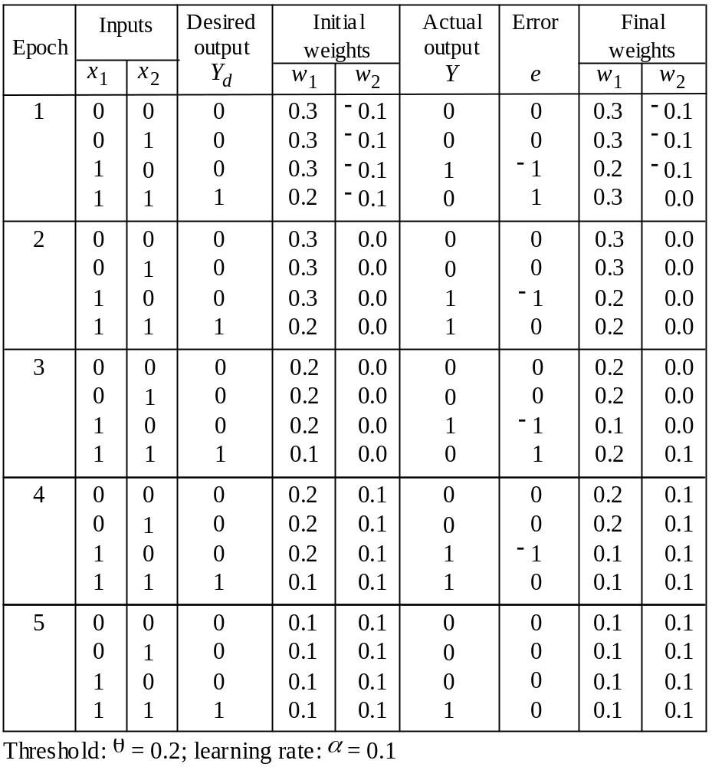
Example of perceptron learning: the logical operation AND

Slide 35
Multi-Layer Neural Networks
research in the more complex networks with more than one layer was very limited until the 1980s
  learning in such networks is much more complicated
  the problem is to assign the blame for an error to the respective units and their weights in a constructive way
the back-propagation learning algorithm can be used to facilitate learning in multi-layer networks

Slide 36
Multi-Layer Neural Networks
The network consists of an input layer of source neurons, at least one middle or hidden layer of computational neurons, and an output layer of computational neurons.
The input signals are propagated in a forward direction on a layer-by-layer basis
  feedforward neural network
the back-propagation learning algorithm can be used for learning in multi-layer networks

Slide 37
Diagram Multi-Layer Network
two-layer network
  input units I_{k}
    usually not counted as a separate layer
  hidden units a_{j}
  output units O_{i}
usually all nodes of one layer have weighted connections to all nodes of the next layer
O_{i}
W_{ji}
a_{j}
W_{kj}
I_{k}

Slide 38
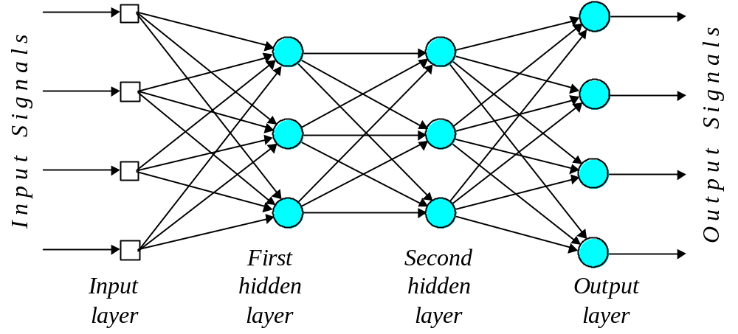
Multilayer perceptron with two hidden layers

Slide 39
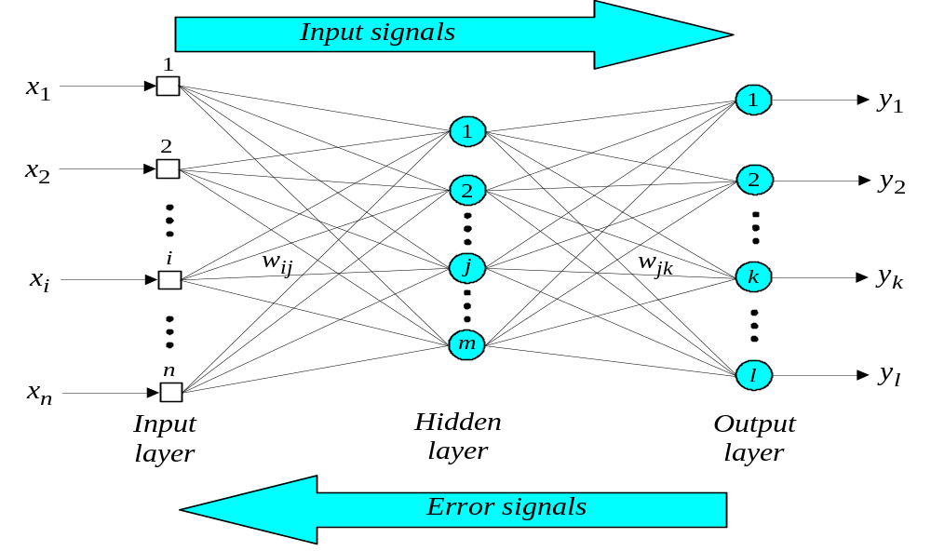
Three-layer Feed-Forward Neural Network
( trained using back-propagation algorithm)

